Slide 1
Running FreeBSD on WSL2 Without Modifying FreeBSD – Working Implementation
+ WSL2
A Work In Progress
Balaje Sankar
AsiaBSDCon 2026 Taipei, Taiwan

Slide 2
About me
Balaje Sankar
Chennai
India
💼
Cloud Architect
Financial Services
balajesankar
@gmail.com
🐡
FreeBSD Tinkerer
Since College
🔧
OS & OSS Enthusiast
x.com/
balajesankar
Open source, Systems and Cloud
🧪
This talk
Personal project — not employer work

Slide 3
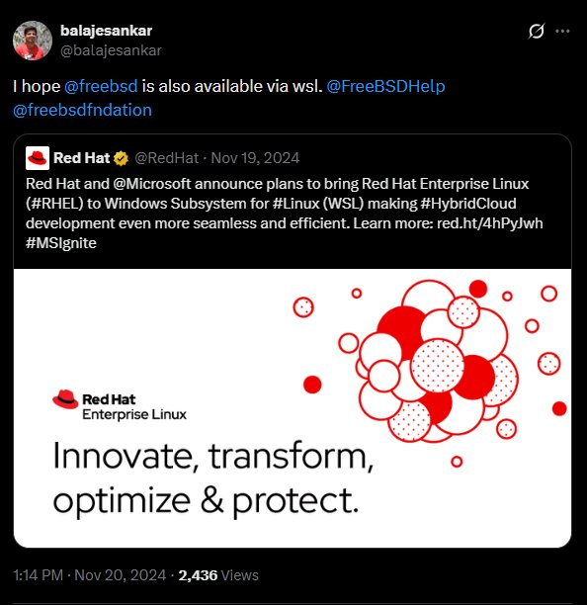
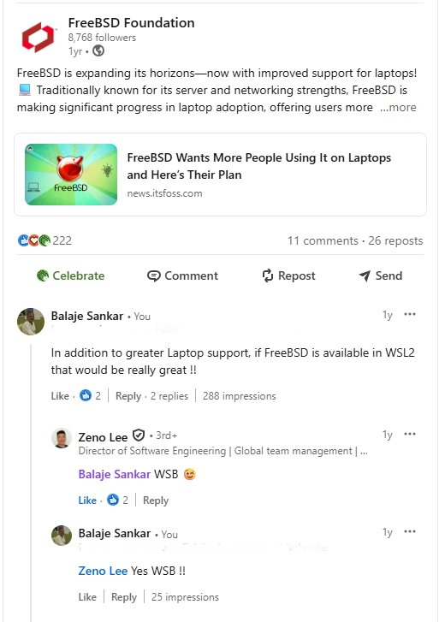
Where It Started
Occasional Informal discussions found in forums showed interest for such an implementation
Personal Interest – Working heterogenous environment
Nov 2024 · Twitter / X
LinkedIn comment thread

Slide 4
Agenda
What is WSL2?
Motivation & Goals
Six Core Technical Challenges
System Architecture
Virtualization Layer (HCS)
Boot Console
hvsock Interface
Initialization Protocol (hvinit)
Interactive Terminal (hvbridge)
Linux vs FreeBSD: side-by-side
Demo · Future Work · Get Involved

Slide 5
What is WSL2?
Windows Subsystem for Linux 2
Run Linux userland natively inside Windows — no dual boot, no full VM
Lightweight Utility VM
Real Linux kernel
Shared filesystem
Integrated terminal
WSL2 was open-sourced in 2024 — enabling projects like this one

Slide 6
Motivation — Why FreeBSD on WSL2?
Access FreeBSD toolset natively inside Windows –
provides additional workflow for developers working on heterogenous environments.
Proves FreeBSD's architectural flexibility in new virtual environments
Zero system modifications —
pure userland integration as below prerequisites already available
AF_HYPERV sockets
Hyper-v support
P9 driver
Personal interest: Frictionless access to FreeBSD from Windows

Slide 7
Six Core Challenges
01
Virtualization Layer
04
Interactive Terminal
Orchestrate FreeBSD VMs via HCS APIs
Connect PTY infrastructure to WSL2 console
02
Guest Handshake
05
Networking
Implement WSL2 init without touching boot
Bridge FreeBSD network stack with WSL2
03
Boot Console
06
File System
Early kernel visibility in WSL2 environment
Enable access to Windows filesystems

Slide 8
System Architecture Overview
Windows Host
FreeBSD VM
wsl.exe
FreeBSD Kernel
(Stock)
WslService
(HCS)
Spawn VM
hvinit
(Lifecycle Agent)
hvbridge
(Console Server)
Red boxes = only userland additions required for WSL2 integration

Slide 9
Linux vs FreeBSD on WSL2
Component | Linux on WSL2 | FreeBSD on WSL2
Kernel | Custom Microsoft kernel | Stock (unmodified)
Boot Method | Custom Kernel + Userland | Self-contained disk image
Init System | Custom mini_init | Standard rc.d + hvinit + hvbridge
Boot Console | virtio-console | serial-console (comconsole)
WSL2 Console | hvsock-based | hvsock-based

Slide 10
Virtualization Layer
Running FreeBSD as a first-class HCS guest

Slide 11
Virtualization Layer — Host Compute Service (HCS)
WSL2 uses HCS API (JSON) — not traditional Hyper-V management
HCS config: CPU, memory, devices, boot params in a single document
FreeBSD runs from a complete VHDX: bootloader + kernel + rootfs
HCS attaches VHDX as SCSI; wires up serial port and hvsock
Boot is bare-metal identical — standard freebsd-update works unchanged

Slide 12
{
"Owner":"WSL",
"SchemaVersion":{
"Major":2,
"Minor":3
},
"ShouldTerminateOnLastHandleClosed":true,
"VirtualMachine":{
"Chipset":{
"Uefi":{
"BootThis":{
"DevicePath":"Primary disk",
"DiskNumber":0,
"DeviceType":"ScsiDrive"
}
}
},
"ComputeTopology":{
"Memory":{
"AllowOvercommit":true,
"BackingPageSize":"Small",
"DirectMapFaultClusterSizeShift":4,
"EnableColdDiscardHint":true,
"EnableDeferredCommit":true,
"FaultClusterSizeShift":4,
"HighMmioBaseInMB":40958,
"HighMmioGapInMB":24578,
"SizeInMB":3360
},
"Processor":{
"Count":2,
"EnablePerfmonLbr":false,
"EnablePerfmonPmu":false
}
}
"Devices":{
"Battery":{
},
,
"ComPorts":{
"0":{
"NamedPipe":"\\\\.\\pipe\\wsl_com_customportnamedpipe"
}
},
"HvSocket":{
"HvSocketConfig":{
"DefaultBindSecurityDescriptor":"D:P(A;;FA;;;SY)(A;;FA;;;S-1-5-21-1179595859-3502412455-849516828-1001)",
"DefaultConnectSecurityDescriptor":"D:P(A;;FA;;;SY)(A;;FA;;;S-1-5-21-1179595859-3502412455-849516828-1001)"
}
},
"Plan9":{
},
"Scsi":{
"Primary disk":{
"Attachments":{
"0":{
"Type":"VirtualDisk",
"Path":"C:\\Dev\\FreeBSD14.3forDemo.vhdx"
}
}
}
}
},
"StopOnReset":true
}
}

Slide 13
Boot Console
Solving the silent boot problem

Slide 14
Boot Console — Serial I/O to the Rescue
autoboot_delay=“0”
beastie_disable="YES”
console="vidconsole,comconsole“
boot_multicons="YES“
boot_serial="YES"
# HCS attaches a COM port; output pipes to Windows console
WSL2 expects virtio-console — unavailable in FreeBSD early boot
comconsole works identically in WSL2 — no changes needed
Full visibility: bootloader → kernel probe → rc.d → login prompt

Slide 15
hvsock Interface
Host-guest communication via AF_HYPERV

Slide 16
hvsock — Port-Based Addressing (Client / Server)
/* hvinit — client, connects to host on port 50000 */
int s = socket(AF_HYPERV, SOCK_STREAM, 0);
addr.hvs_port = 50000;
connect(s, (struct sockaddr*)&addr, sizeof(addr));
/* hvbridge — server, listens on port 60000 */
addr.hvs_port = 60000;
bind(s, ...); listen(s, 10);
int client = accept(s, NULL, NULL);
sockaddr_hvs recreated in userspace — no kernel headers needed
Windows manages GUIDs internally; FreeBSD uses plain integer ports

Slide 17
hvinit — WSL2 Utility VM Handshake (sockaddr_hvs)
struct sockaddr_hvs {
unsigned char sa_len;
sa_family_t sa_family;
unsigned int hvs_port;
unsigned char hvs_zero[sizeof(struct sockaddr) -
sizeof(sa_family_t) -
sizeof(unsigned char) -
sizeof(unsigned int)];
};

Slide 18
Initialization Protocol
hvinit — the WSL2 handshake

Slide 19
hvinit — WSL2 Utility VM Handshake
Linux uses custom mini_init; FreeBSD uses a plain rc.d service
Three sequential connections to port 50000:
• Capability socket — announces FreeBSD identity + kernel version
• Notify socket — persistent channel for VM lifecycle events
• Init socket — config exchange; advertises hvbridge on port 60000
Keeps channels open for VM lifetime; errors reported back to host

Slide 20
Interactive Terminal
hvbridge — PTY meets hvsock

Slide 21
hvbridge — Interactive Console Bridge
Listens on port 60000; accepts 7 sequential host connections:
1. Handshake 2. Terminal dimensions + env 3–5. stdin/stdout/stderr
6–7. Aux channels for interop
forkpty() spawns /bin/sh; select() relays data bidirectionally

Slide 22
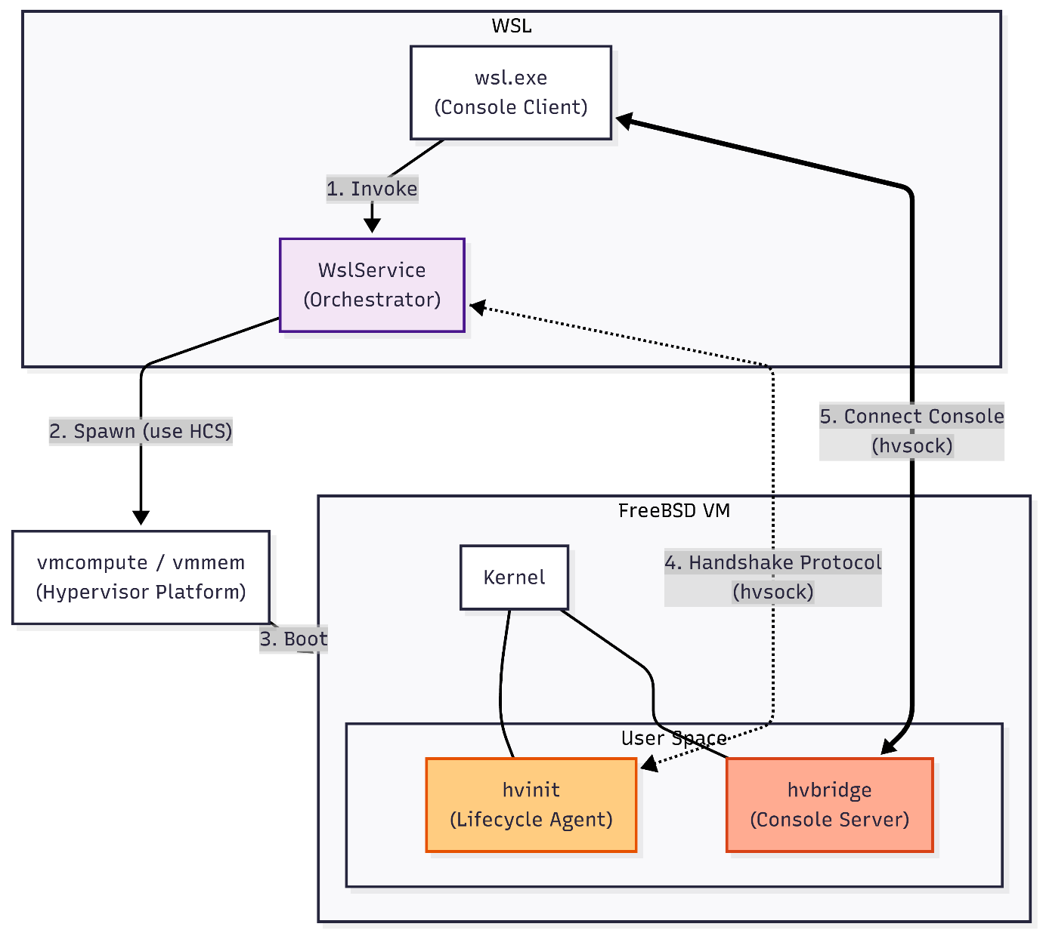
Detailed Flow

Slide 23
Why FreeBSD's Design Made This Possible
FreeBSD Strengths Leveraged
Unmodified Out of the Box
Mature uart(4)/comconsole for headless boot
Native AF_HYPERV (hvsock) in 14.3 mainline
Clean kernel/userland separation
Standard rc.d for integration daemons
Self-contained VHDX boot model
FreeBSD kernel — 100% stock
Boot process identical to bare-metal

Slide 24
Live Demo
Launch FreeBSD via wsl.exe on Windows
Interactive shell in Windows Terminal
Native commands: uname -a, vi, man.networking etc
Also at available at : x.com/balajesankar/status/1970585411153207715

Slide 25
In Progress
Guest Networking (GNS)
Automatic network config via WSL2 Host Network service (HNS) – currently static config
Seamless connectivity between FreeBSD, Windows host, and internet
File System Integration
9P client to mount Windows filesystems (e.g. /mnt/c)
Bidirectional file access between guest and host
Full lifecycle management

Slide 26
Get Involved
This is early-stage — every contribution shapes the direction
https://github.com/BalajeS/WSL-For-FreeBSD
balajesankar@gmail.com

Slide 27
Thank You
FreeBSD's architectural maturity enables seamless adaptation
to new virtualization environments — no kernel modifications required.
Questions?

